Slide 1
Data source - Dataset
120-years-of-olympic-history-athletes-and-results - kaggle
athlete_events.csv
noc_regions.csv

Slide 2
Hypothesis Testing
T – Test

Slide 3
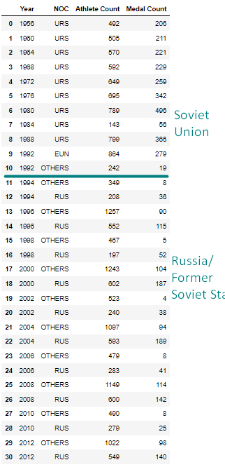
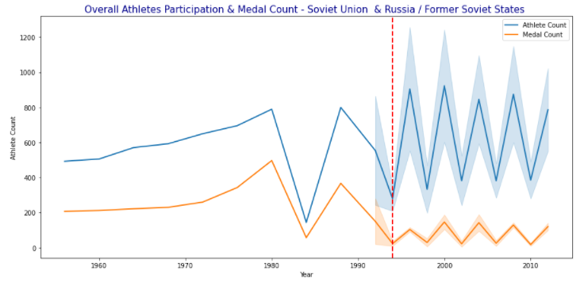
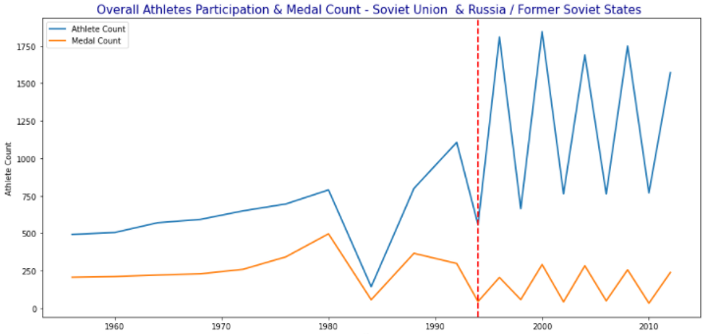
Compete Analysis– Future Analysis Soviet Union Vs. Russia /Former Soviet States
Scope of our project is narrowed down to analyze the impact of dissolution on the performance of Russia in Olympics before and after 1992 .
Did the dissolution impact the participation rate and total medals won by Soviet Union as a team vs. Russia / Former Soviet States.
The athlete's participation went up, but the number of medals went down after 1992 Olympics
#The former Soviet states referred as OTHERS are Armenia, Azerbaijan, Belarus, Estonia, Georgia, Kazakhstan, Kyrgyzstan, Latvia, Lithuania, Moldova, Tajikistan, Turkmenistan, Ukraine and Uzbekistan
other_counties_list= ['ARM','MDA','EST','LAT','LTU','GEO','AZE','TJK','KGZ','BLR','UZB','TKM','UKR','KAZ']

Slide 4
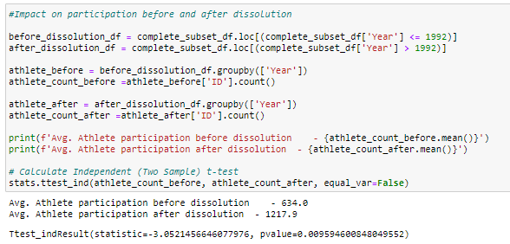
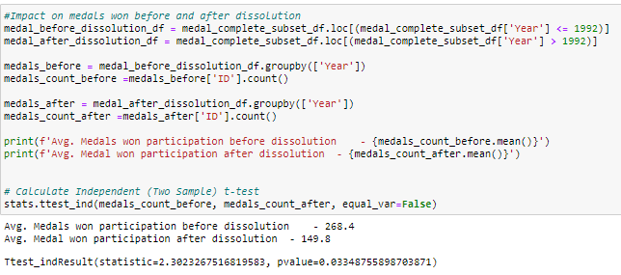
Complete Analysis - TTest Soviet Union Vs. Russia /Former Soviet States
1. Did the dissolution impact the athlete’s participation in Olympics before and after 1992?
Athlete Participation Analysis : The average participation of athletes went up drastically. The t-test shows p-value of 0.0095 indicating strong evidence against the null hypothesis and therefore we can reject the Null hypothesis and accept alternate hypothesis
2. Did the dissolution impact the total number of medals before and after 1992?
Medals won Analysis : The p-value for medal analysis is 0.003 .It indicates evidence against the null hypothesis, as there is less than a 5% probability the null is correct (and the results are random). Therefore, we reject the null hypothesis, and accept the alternative hypothesis for our further analysis
complete_noc_list = ['URS','EUN','RUS','ARM','MDA','EST','LAT','LTU','GEO','AZE','TJK','KGZ','BLR','UZB','TKM','UKR','KAZ’]
#Includes Soviet Union, Russia and other countries part of former USSR
complete_subset_df =olympics_dataset[olympics_dataset['NOC'].isin(complete_noc_list) & (olympics_dataset['Year'] >= 1956) & (olympics_dataset['Year'] <= 2012)]

Slide 5
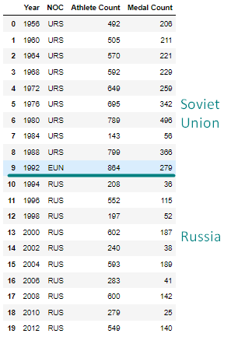
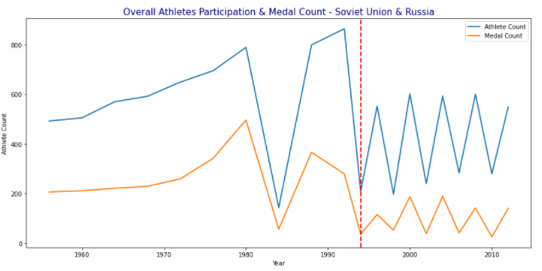
Project Scope Analysis Soviet Union and Russia
Scope of our project is narrowed down to analyze the impact of dissolution on the performance of Russia in Olympics before and after 1992 .

Slide 6
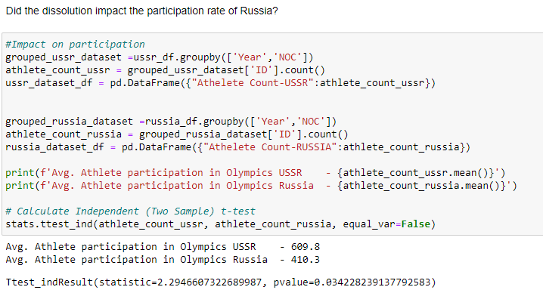
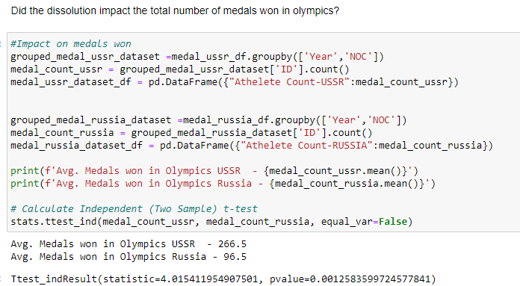
Project Scope Analysis - TTest Soviet Union Vs. Russia
1. Did the dissolution impact the athlete’s participation rate for Russia?
Athlete Participation Analysis : The average athlete participation for Russia after dissolution is lower than that of URS, but this is understandable given that the data excludes other countries’ participation. The p-value of 0.034 in the t-test indicates that there is evidence against the null hypothesis, thus we can reject the null hypothesis and accept the alternate hypothesis for our further analysis.
2. Did the dissolution impact the total number of medals by Russia?
Medals won Analysis : The p-value for medal analysis is 0.0012 .It indicates strong evidence against the null hypothesis, as there is less than a 5% probability the null is correct (and the results are random). Therefore, we reject the null hypothesis, and accept the alternative hypothesis for our further analysis
#USSR Dataset [1956 - 1992]
ussr_df = complete_subset_df.loc[((complete_subset_df['NOC'] == 'URS' )|(complete_subset_df['NOC'] == 'EUN'))]
# Russia DataSet [1994 - 2012]
russia_df = complete_subset_df.loc[(complete_subset_df['NOC'] == 'RUS')]

Slide 7
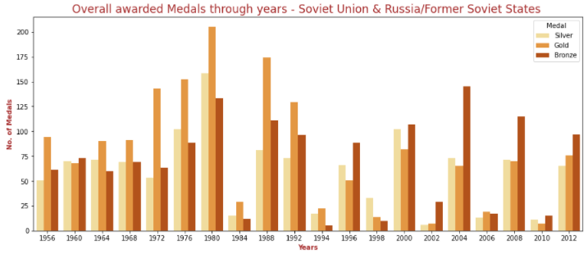
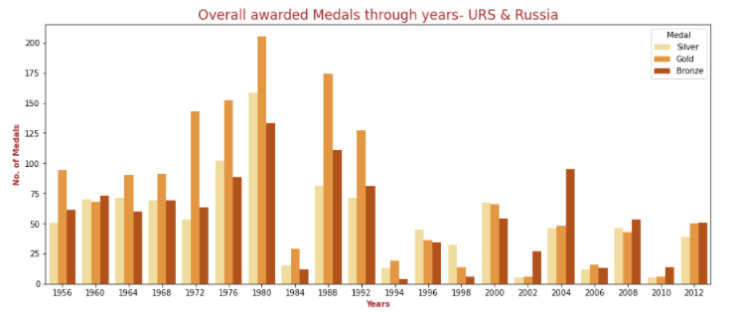
Extra Charts

